Slide 1

Internet Privacy Policies
Denali Stevens

Slide 2
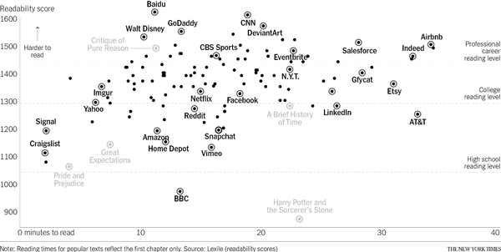
Does anyone actually read the privacy policy?
Notes:
Anyone in here a member of Airbnb? How long did it take you to sign up? Add 30-40 minutes to that time if you take the care to read the privacy policy, and more than that if you take the time to actually understand/comprehend the information.

Slide 3
Anyone Read Harry Potter?
x
Notes:
The beauty of Harry Potter is that anyone can read it. It’s a very easy reading level and actually doesn’t take that long to read. Let’s compare with the New York Times privacy policy. The length of time it would take to read the NY times privacy policy is about the same as the first chapter of harry potter, but the NY times policy is significantly harder to understand. So sure, you can read every word in roughly 25 minutes, but how much of it will you actually understand?

Slide 4
Which one(s) would you read?
Notes:
I think its fair to say we all have a college reading level, so realistically we can reasonably comprehend this area. Personally I’ve never read a privacy policy for any app or membership, but if I had to the only ones I would chose to read would be Craigslist or Signal (whatever that is) – or maybe BBC

